Slide 2
Dashboard
A dashboard is a consolidated display of many worksheets and related information in a single place. It is used to compare and monitor a variety of data simultaneously.
When we modify a worksheet the dashboard is updated automatically and vice versa.
The different data views are displayed all at once.

Slide 3
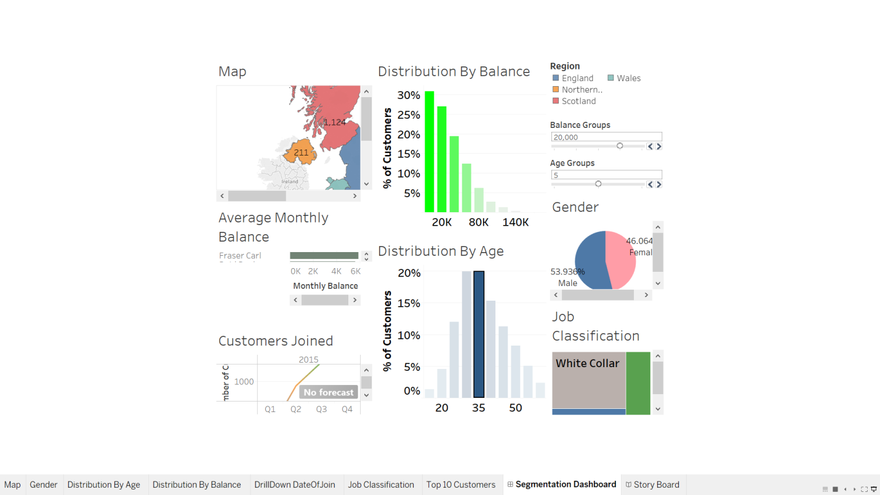

Slide 4
Story Line
Tableau story points is also a dashboard in which you provide a narration of the visualizations.
Some thing like saying what we can observe from the visualizations. People tend to understand and remember concepts through stories. Using tableau you can tell a story with data, just as you can tell a story with text or with film.
Story Points gives anyone the tools to create a narrative with data without any programming knowledge.

Slide 5
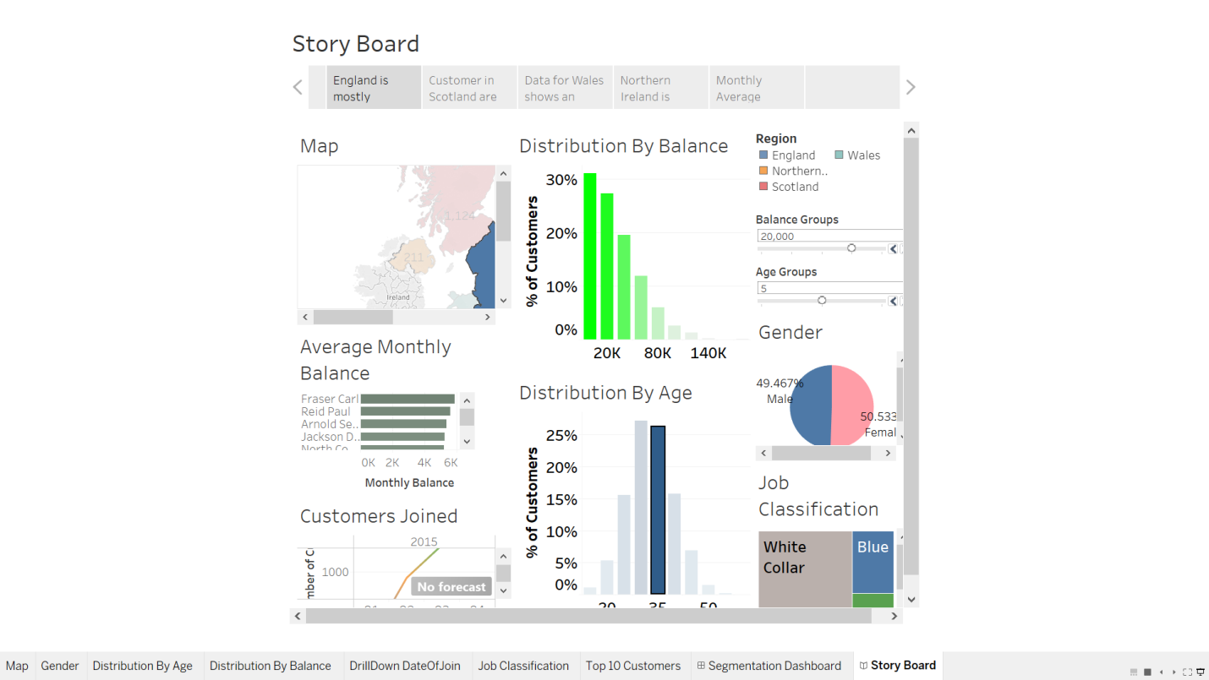

Slide 6
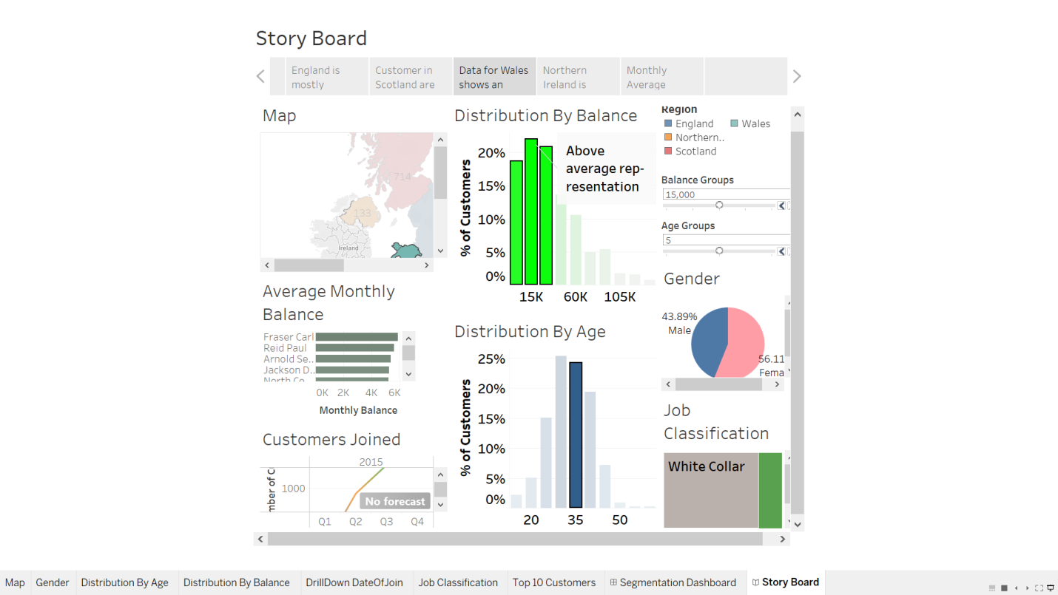

Slide 7
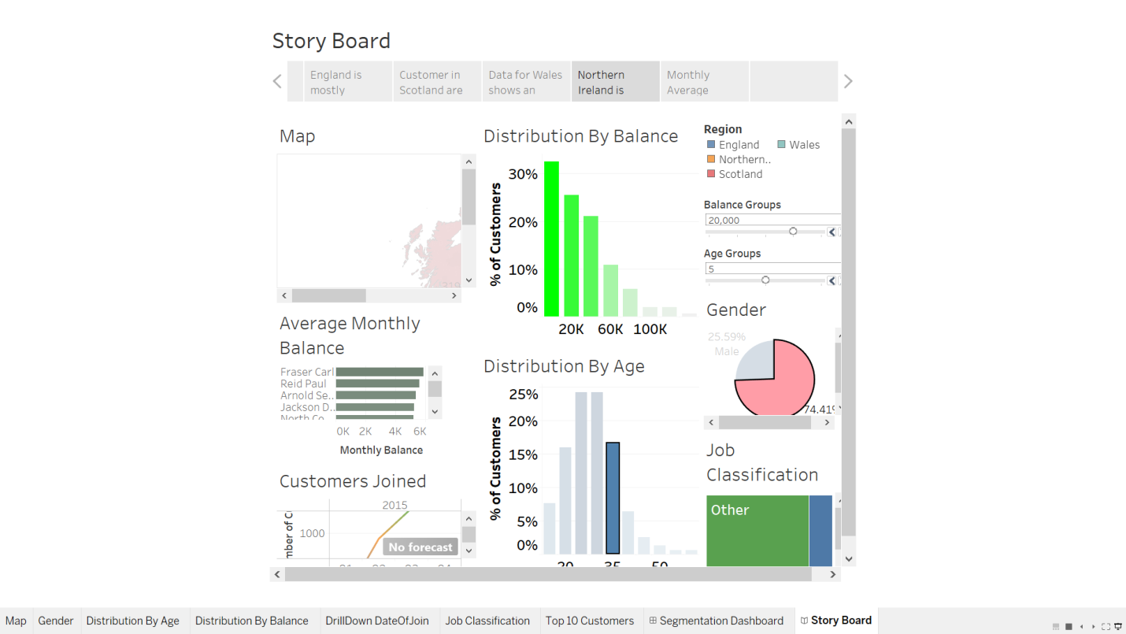

Slide 8
